Slide 1
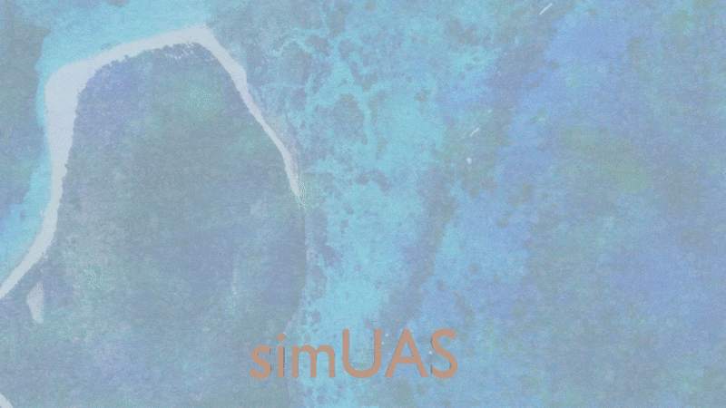
Refraction Simulations
9/15/2017

Slide 2
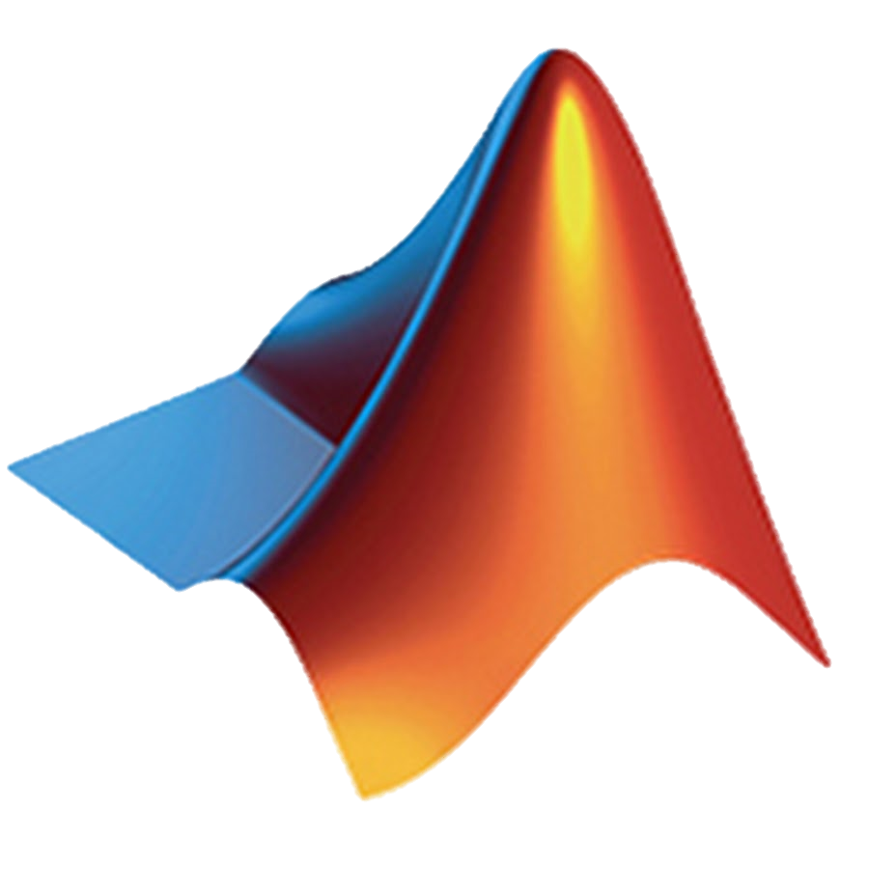



Processing Workflow
Matlab
Generate Simulation XML Files
user input
simUAS (Blender + Python + Matlab)
Batch Process Simulations
Output Simulated Imagery and Metadata
Workflow is mostly automated
XML schema used as input to both simUAS and agiproc
Matlab is used to generate XML files due to familiarity
Matlab
Generate Photoscan Processing XML Files
user input
Agiproc (Photoscan + Python)
Process all simulations in Photoscan
Output Pointcloud and other Computed Parameters
Matlab
Process and Analyze Data
Generate Figures + Computed Equations
user input

Slide 3
Goal: Simulate SfM Refraction Induced Error
Water IOR = 1.33
Perceived Location
Error
True Location

Slide 4
Simple Experiment Introducing Refraction
Z = Altitude
hFOV
Z = 0
Overlap %
Water IOR = 1.33
Z = -depth
“Water Bucket Experiment”

Slide 5
Overlap Percent Computed at Water Surface. Actual Overlap increases with depth
Z = Altitude
hFOV
Z = 0
Overlap %
Water IOR = 1.33
“actual” Overlap % ( not used)
Z = -depth
“Water Bucket Experiment”
Notes:
“actual overlap increases with depth”

Slide 6
Wider hFOV means camera positions must be more spread out to maintain overlap %
Z = Altitude
Z = 0
Overlap %
Water IOR = 1.33
Z = -depth
“Water Bucket Experiment”

Slide 7
Texture on Seafloor is also scaled to ensure consistent texture between experiments
Z = Altitude
Z = 0
Overlap %
Water IOR = 1.33
Z = -depth
WaterBucketExperiment

Slide 8
For this experiment with flat water, absolute altitude does not change results
=
*This will change if surface waves are added

Slide 9
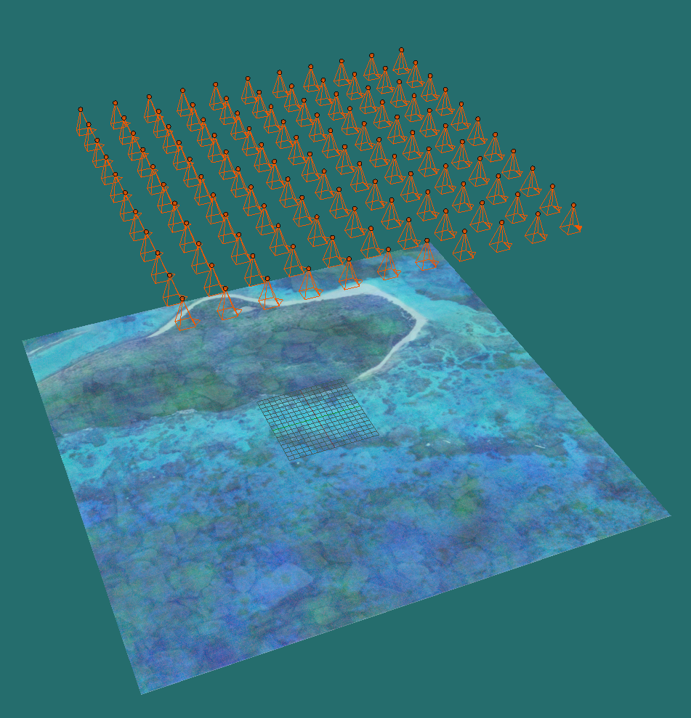
Fishtank Experiment Simulations
Buck Island Texture with Random RGB Noise
121 Images
Flight Lines: 11 x 11
2000 x 2000 pix
No Nonlinear Distortion
Perfect nadir and uniformly spaced EO
80% Overlap/Sidelap (at water surface)
100% Transparent water
No Specular Reflections
Notes:
Replace this figure

Slide 10
Pointcloud accuracy is broken into 3 regions
Each Dot represents a camera position
This arrangement represents:
80% overlap
80% sidelap
Square Image
Northing
Region A:
All Data
Region B:
Clip with Flight Lines
Image FOV
Region C:
Clip by Full Viewing Geometry
Easting

Slide 11
Water Bucket Experiment Simulations (121)
Experiment Parameters
Altitude = 50m
Water Depth/Altitude = [0.01, 0.05, 0.10, … , 0.50] (11)
hFOV = [30,40,50,…,120] (10)
Agisoft Processing Parameters
Trajectory Input With No Uncertainty Added
Camera Position Accuracy = 0.01m
Camera IO set as Fixed
General Alignment = Medium
Optimization On
Dense Reconstruction = Medium, Filter = Aggressive

Slide 12
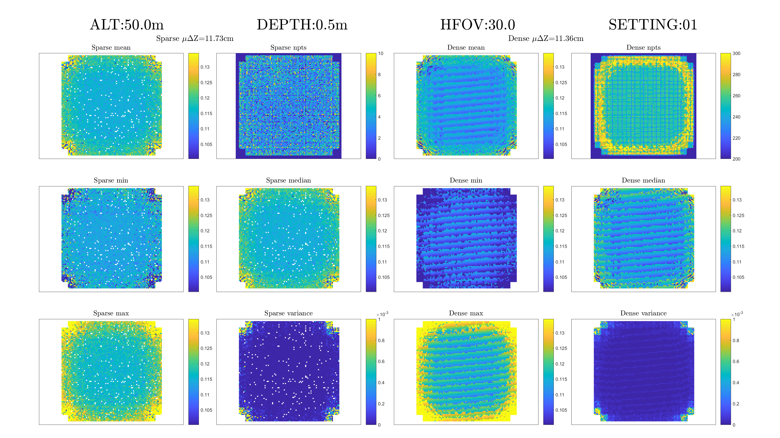
Pointcloud For Each Simulation is Processed in Matlab (Region B Used)

Slide 13
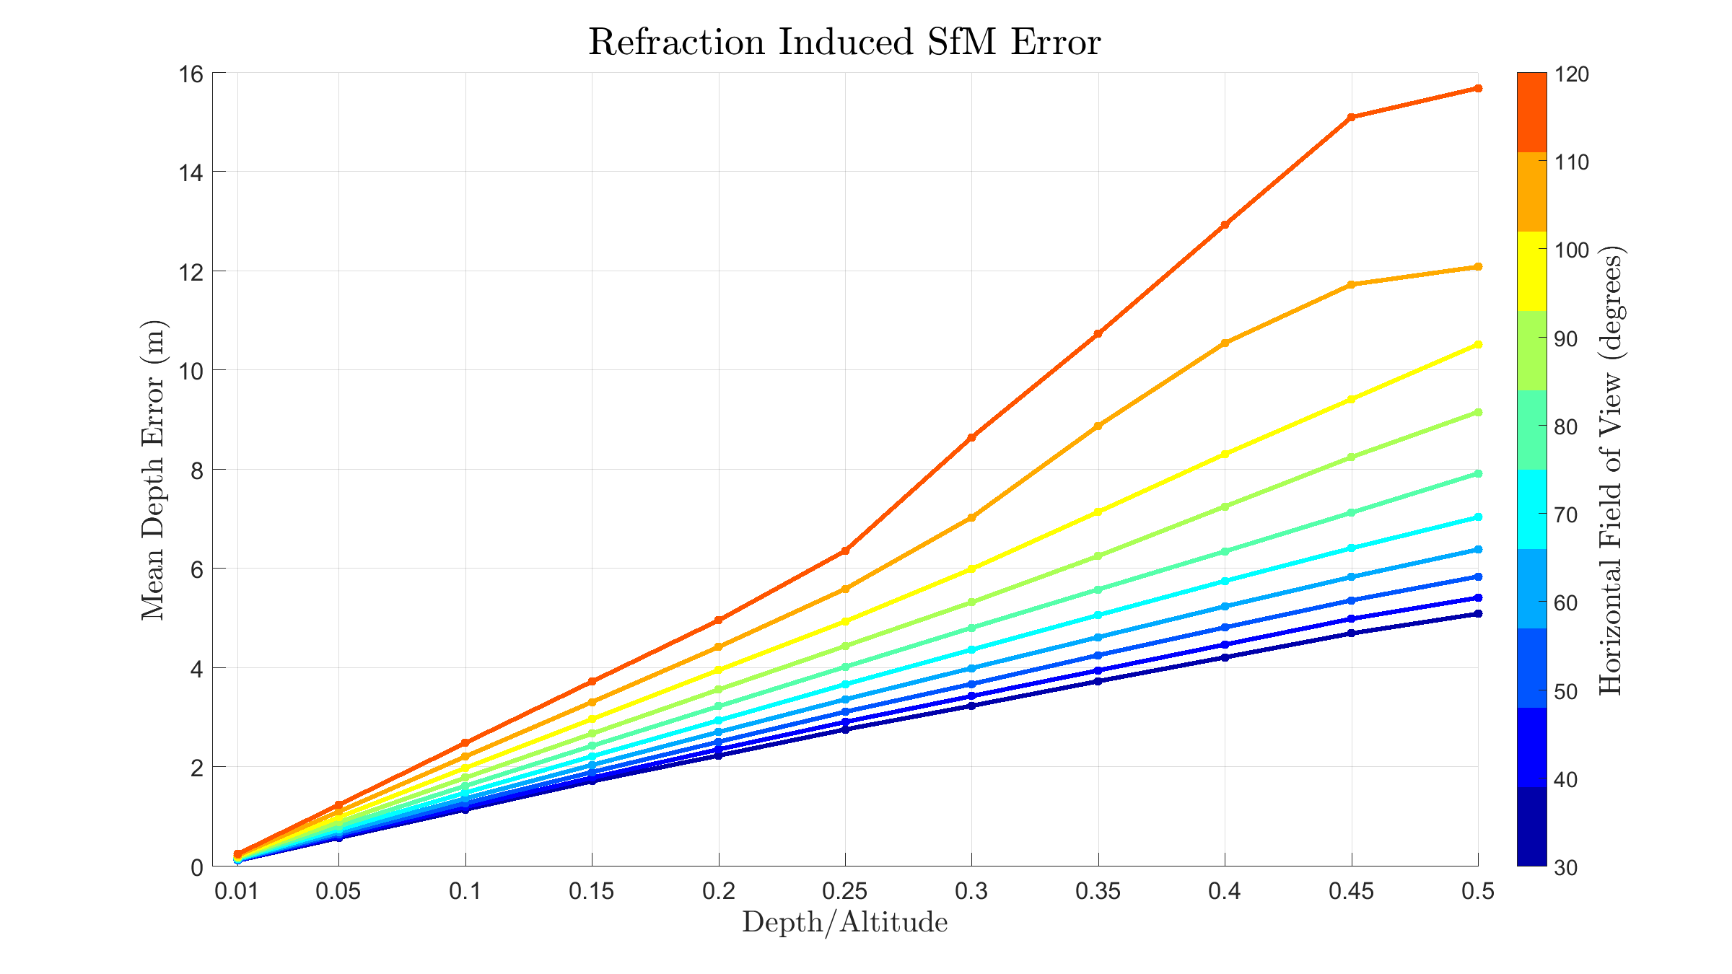

Slide 14
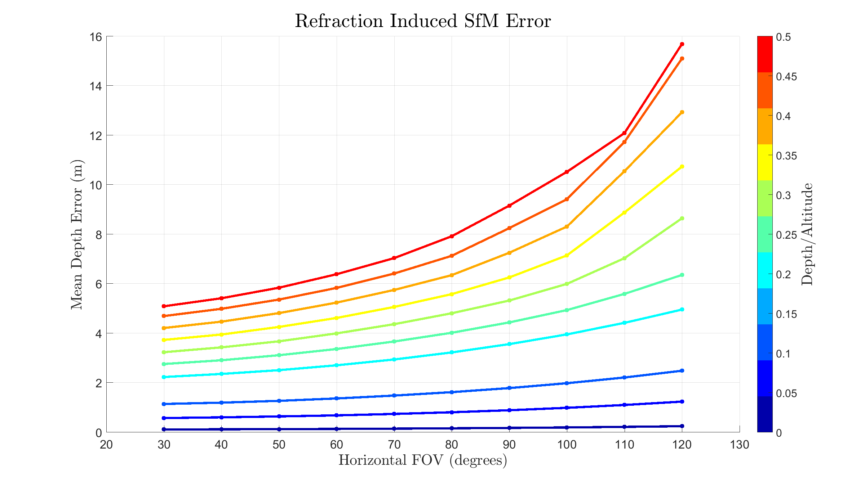

Slide 15
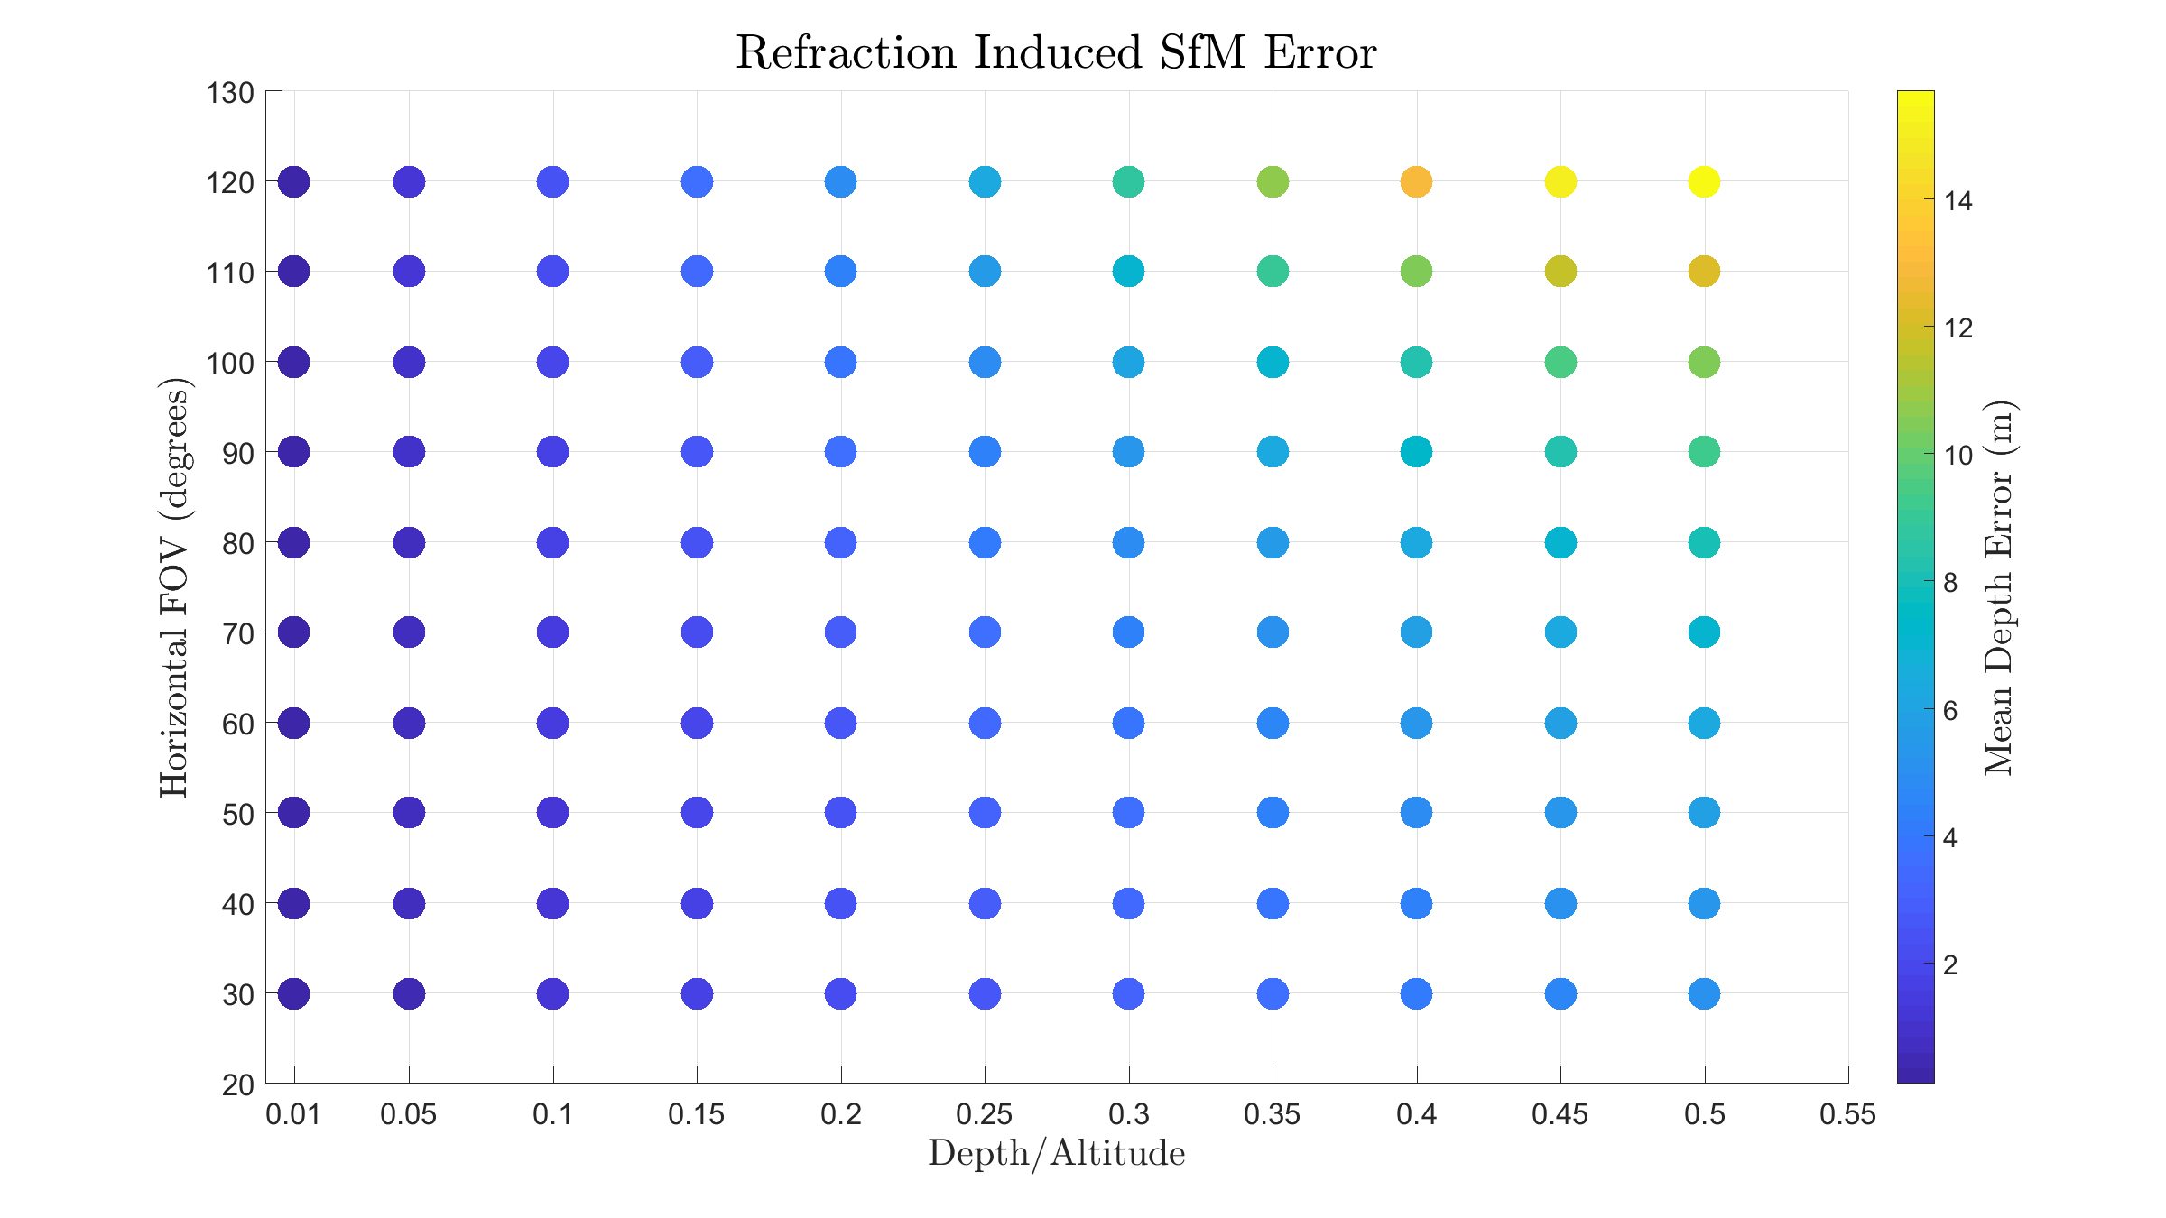

Slide 16
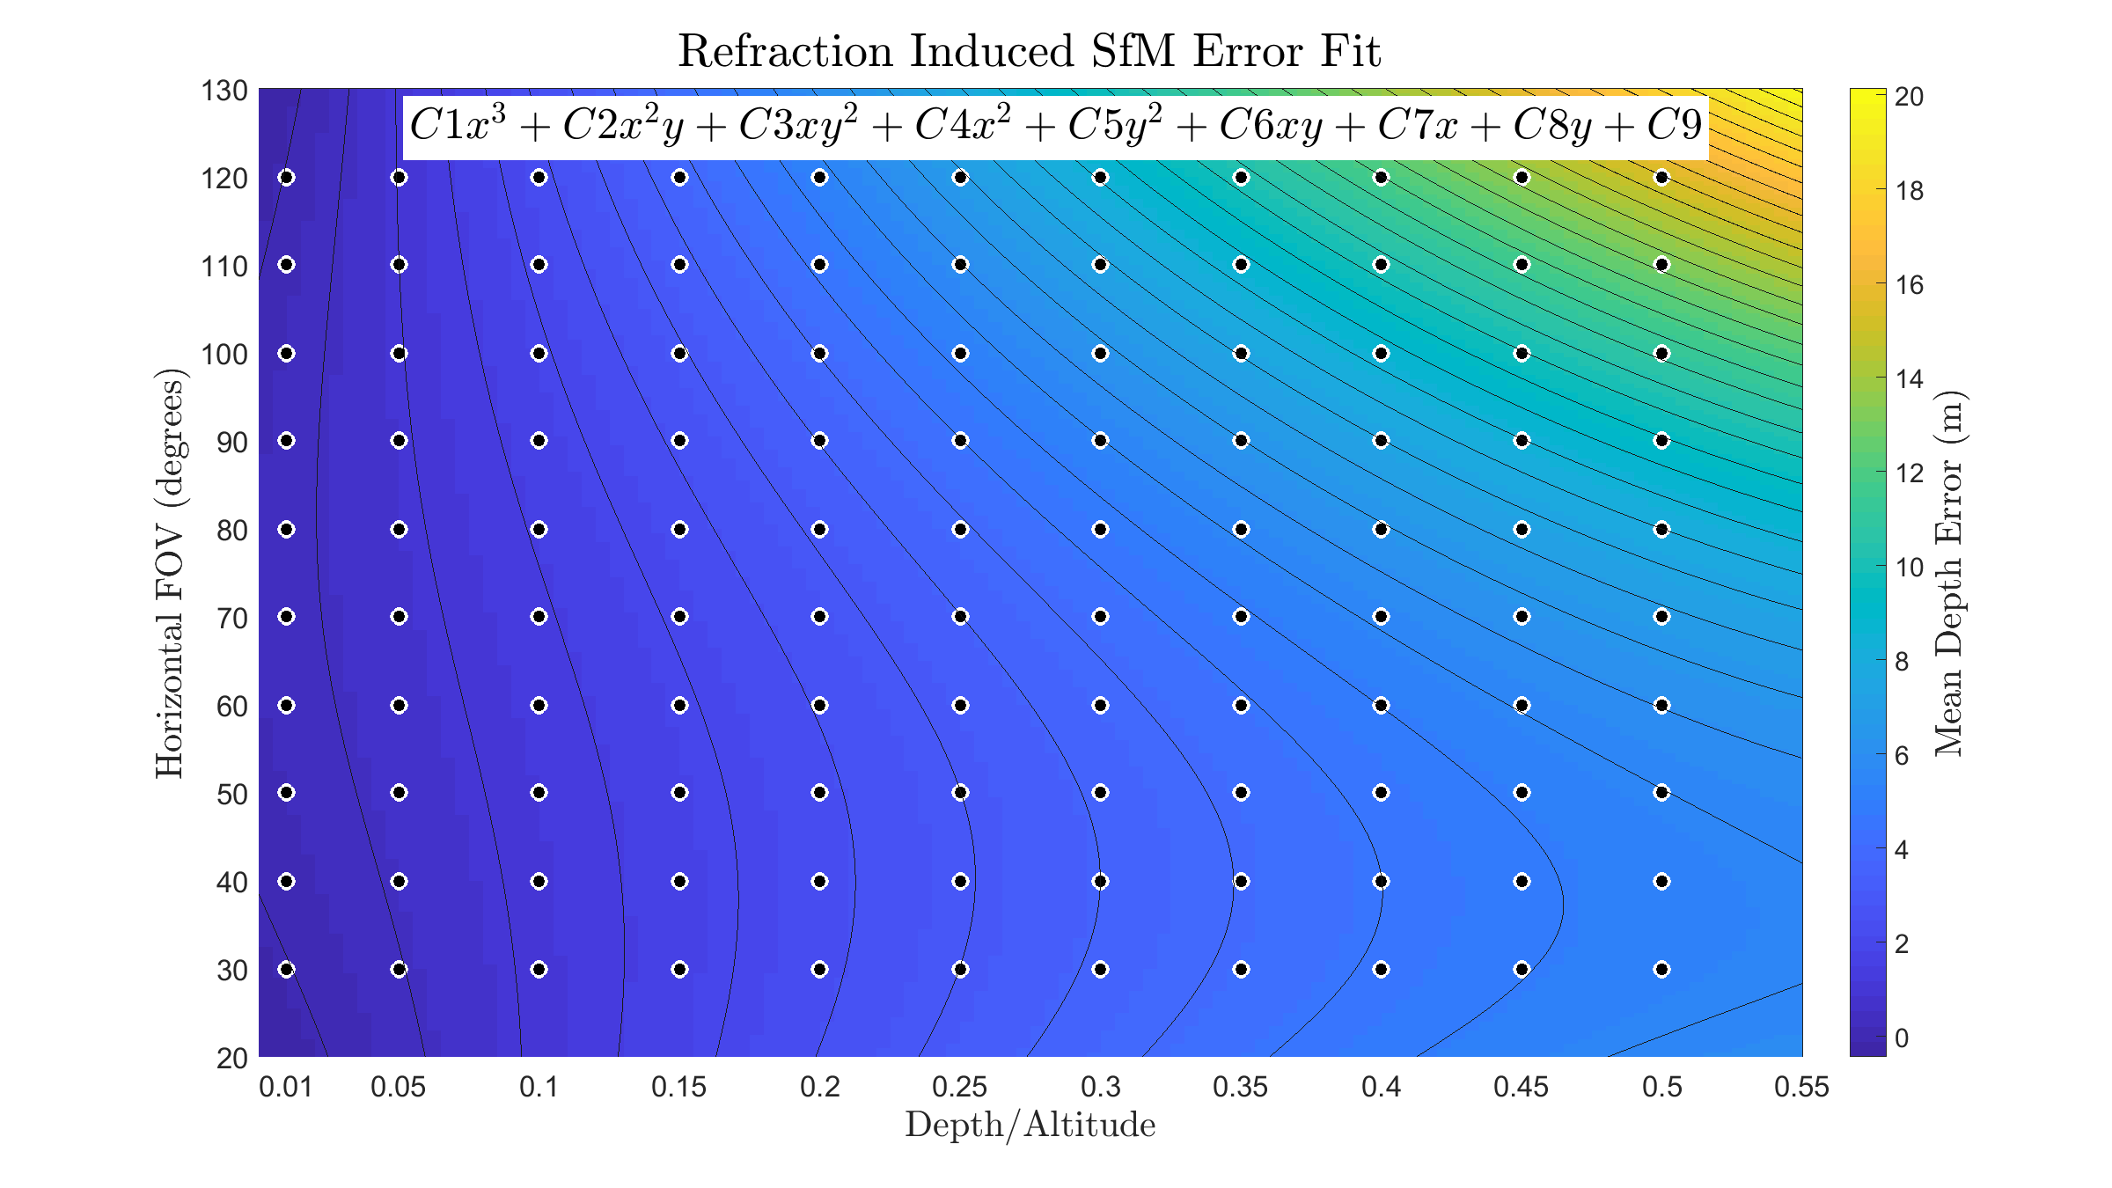

Slide 17
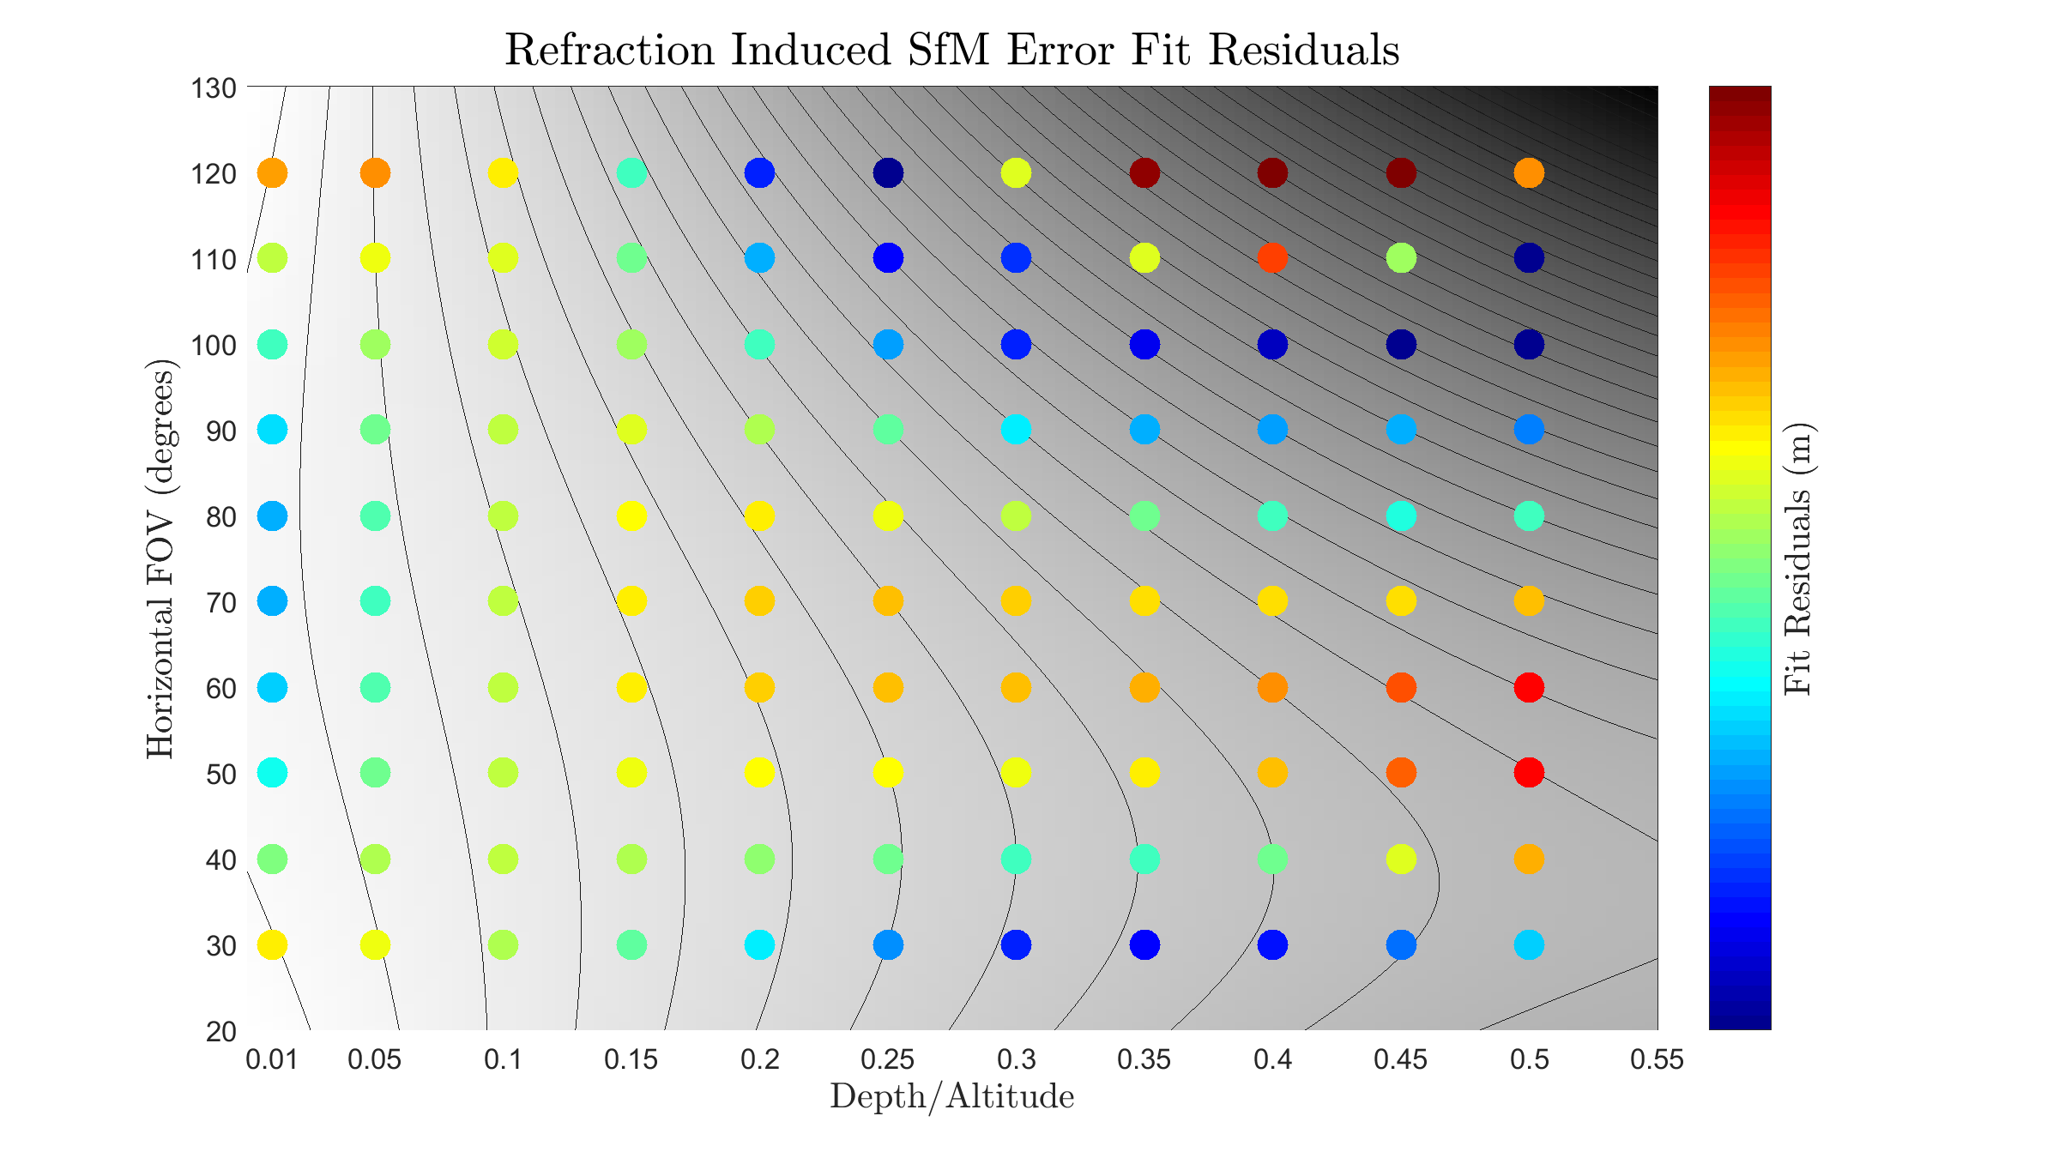
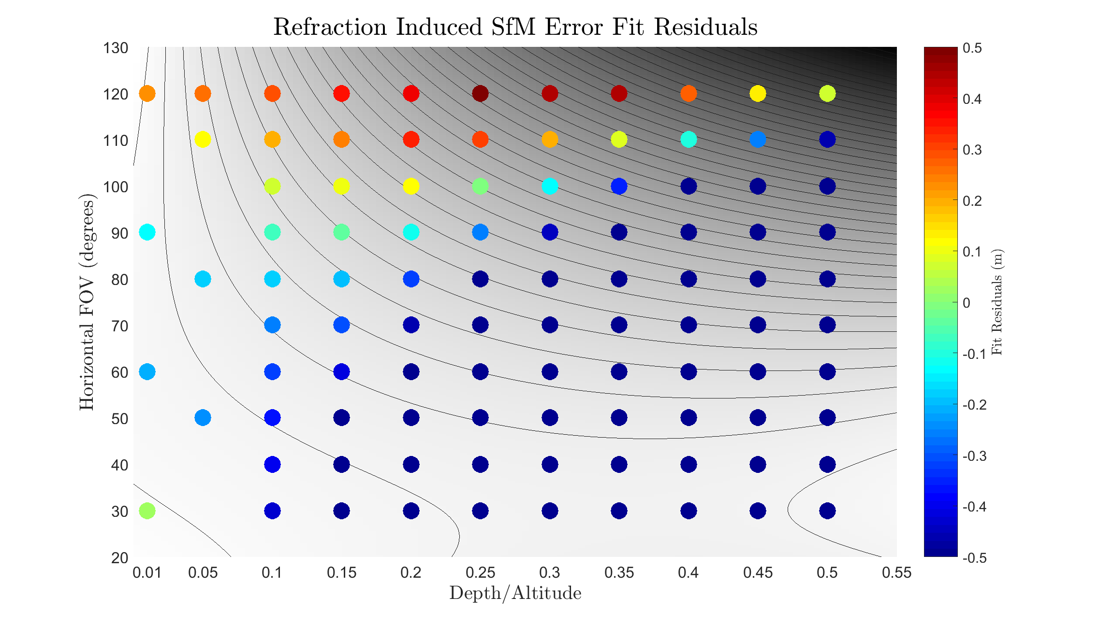

Slide 18
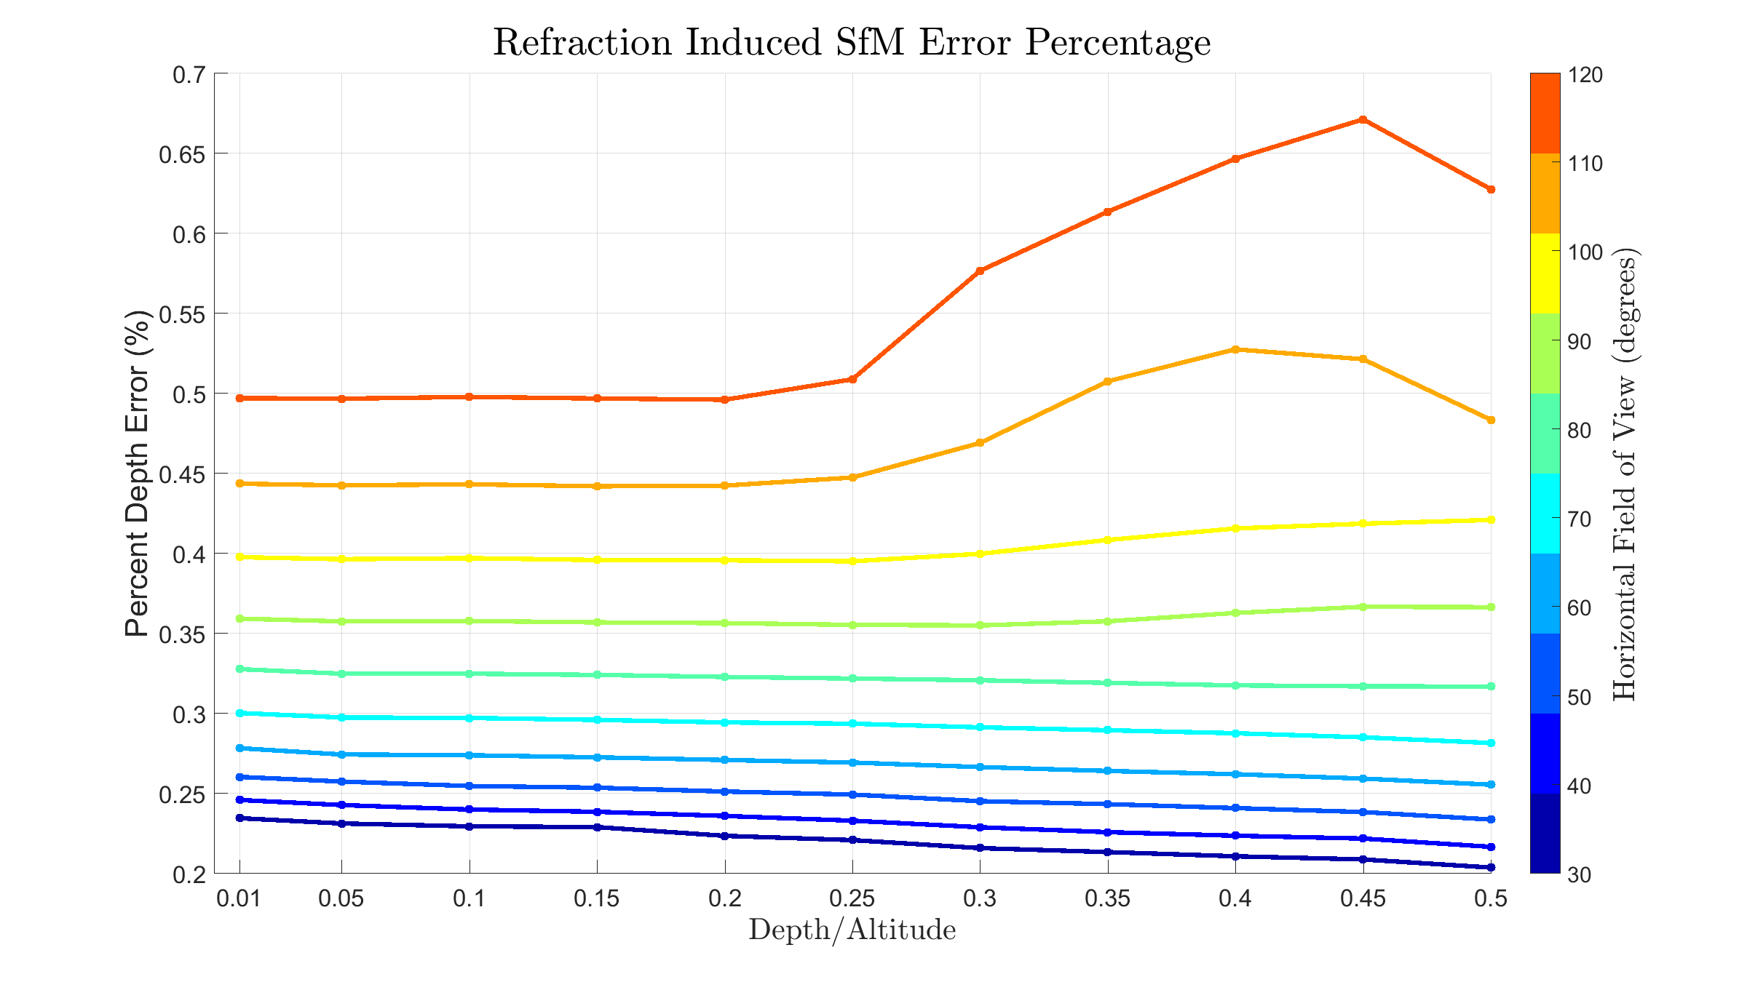

Slide 19
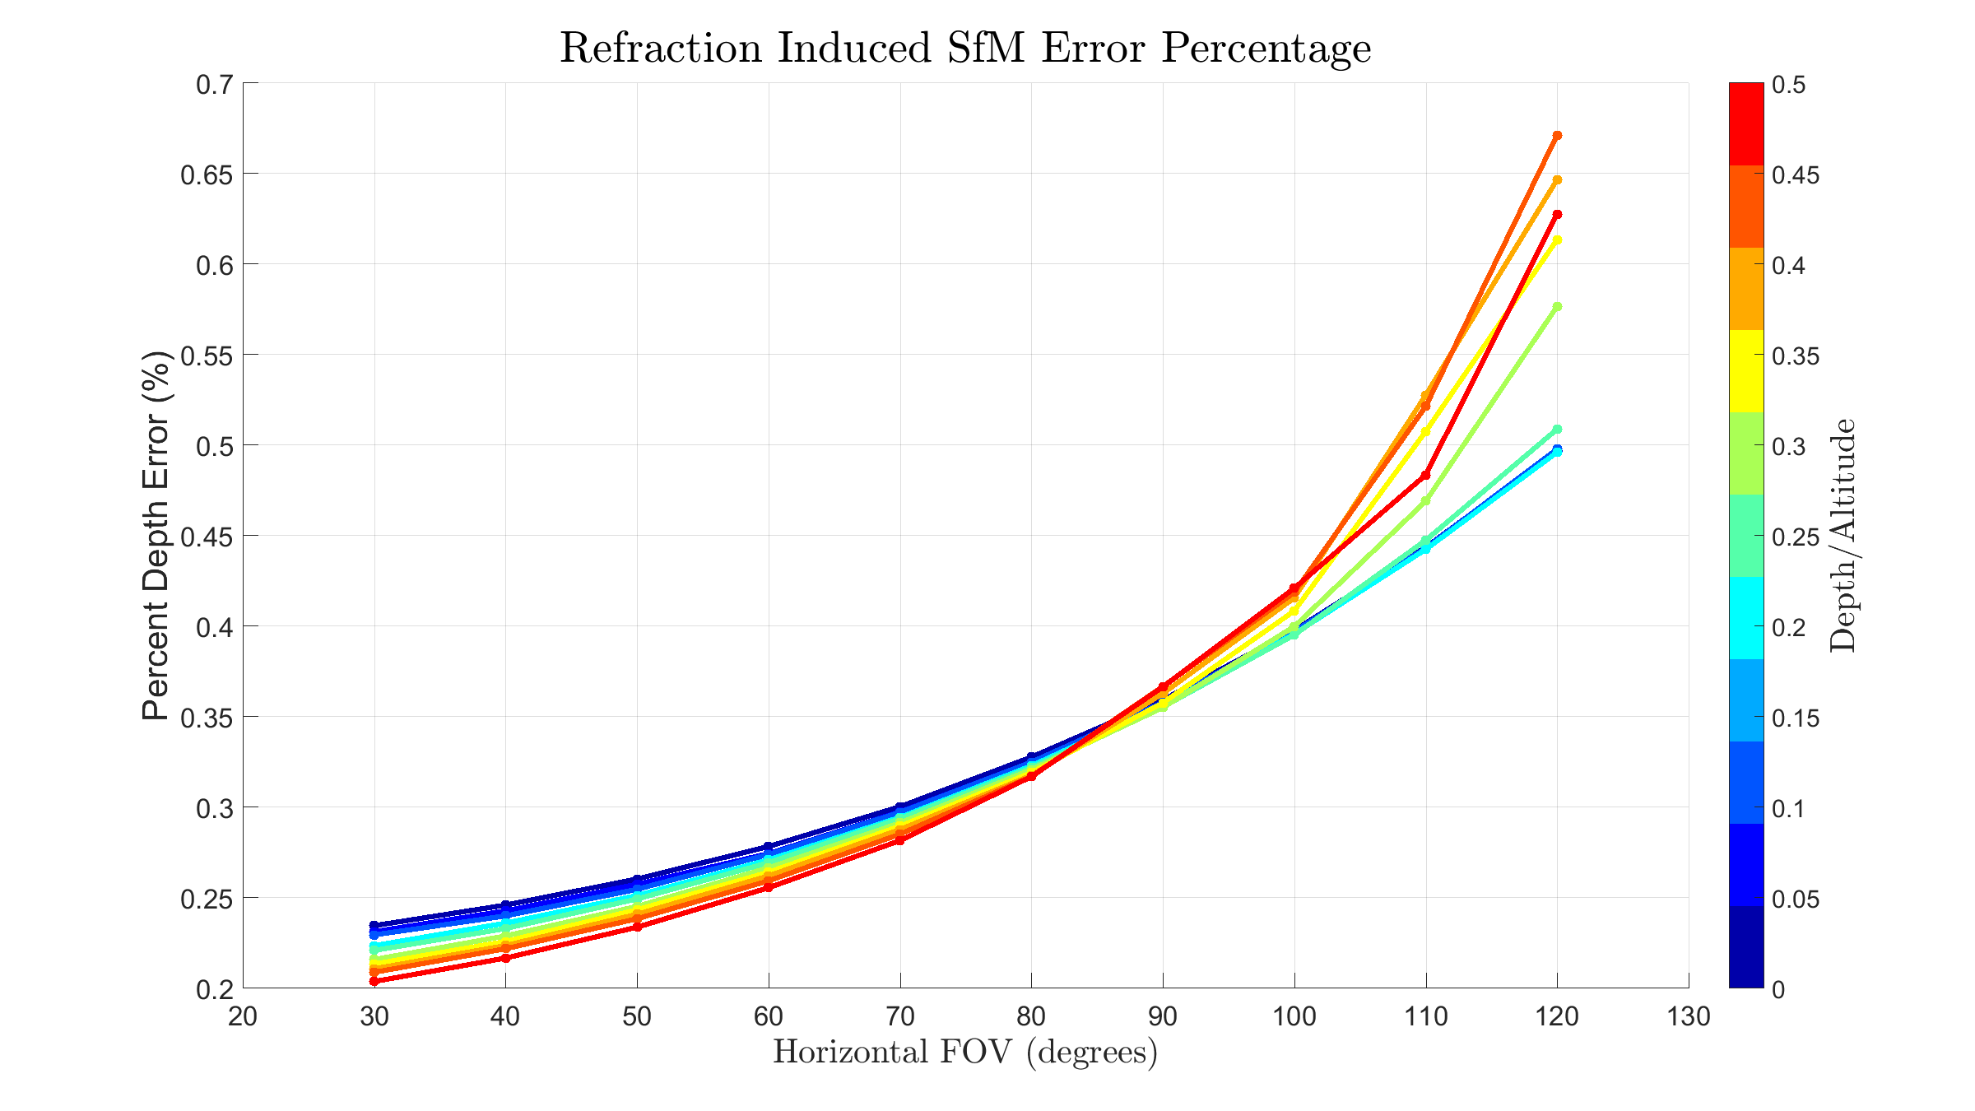

Slide 20
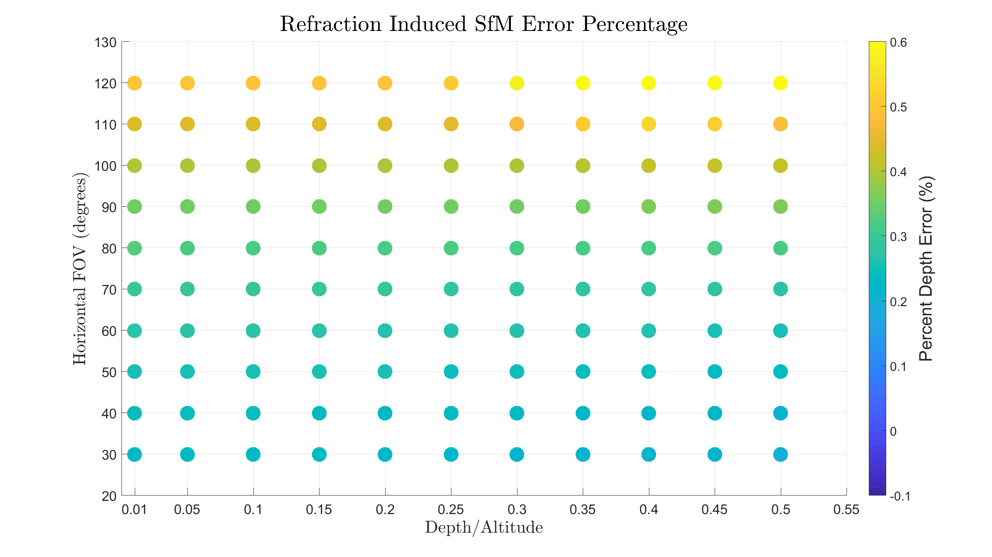

Slide 21
Further Exploration of this Experiment
Replicate plots for other bulk statistics (variance, median, etc)
Compute local variance (eg. Fuzz in the data)
Effect of Agisoft camera EO accuracy parameter
Differentiate Statistics for each “Region”
Northing
Easting

Slide 22
Future Work
Equation for depth correction as a function of
Altitude
Depth
Field of View
Test Equation Validity
More advanced simulations with less “perfect” imagery
Real world data

Slide 23
Future Experiments?
Accuracy as a function of:
RTK Accuracy
Distribution of Above/Below Water GCPs
Wave Field (Period, Amplitude, Frequency Spectrum)
Non-Nadir Imagery
Variable Bathymetric Depths and Slopes
Overlap/Sidelap
Bottom Texture
IOR Accuracy
Camera Nonlinear Distortion

